Slide 1

SALES PREDICTION
GROUP 11

Slide 2

GROUP MEMBERS
S.NO | NAME | ROLL NO
1. | AKSSHAYA R | CB.EN.U4CCE20005
2. | DHASHYANTH N | CB.EN.U4CCE20018
3. | HEMCHAND R | CB.EN.U4CCE20024
4. | PRIYANGA R | CB.EN.U4CCE20045

Slide 3
OBJECTIVE
The main objective of this project work is to find out the reliable sales trend prediction which is implemented by using data mining and ML techniques to get an insight on how a company should manage cash flow and resources.
The prime idea is to envisage the pattern of sales and the quantities of the products to be sold based on some key features gathered from the raw data we have.
Analysis would help the business organizations to make a probabilistic decision at each important stage of marketing strategy.

Slide 4
INTRODUCTION
Today’s business handles large amount of data which is growing exponentially.
Predicting manually could lead to drastic error and poor management in the organization and most importantly time consuming which is not desirable.
An optimal way of predicting has become essential for all the vendors to sustain the efficacy of the marketing organizations.
In our project, Supervised machine learning models are used which can accurately predict the results
The Attributes used in Supermarket Data Set:

Slide 5

RELATED WORK
’Walmart's Sales Data Analysis - A Big Data Analytics perspective’-In this study, inspection of the data collected from a retail store and prediction of the future strategies related to the store management is executed. Effect of various sequence of events such as the climatic conditions, holidays etc. Can actually modify the state of different departments so it also studies this effects and examines its influence on sales.
’Sales Prediction System Using Machine Learning’ In this paper, the objective is to get proper results for predicting the future sales or demands of a firm by applying techniques like Clustering Models and measures for sales predictions. The potential of the algorithmic methods are estimated and accordingly used in further research
Intelligent Sales Prediction Using Machine Learning Techniques- iCCECE_Paper_procedings. The objective was to find the trends in sales with the past data of sales.

Slide 6
MOTIVATION
Sales Prediction allows set clear goals and expectations for businesses.
Manually predicting sales can lead to errors as well as time consuming.
Thus, using data mining and machine learning techniques are the need of the hour as these methods are less time consuming and more accurate and efficient
To gain knowledge about new classifiers

Slide 7
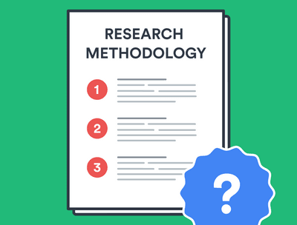
METHODOLOGY
To predict the sales, different data mining techniques were undertaken.
Data Collection
Data Pre-processing
Outlier detection
Correlation
Classification

Slide 8
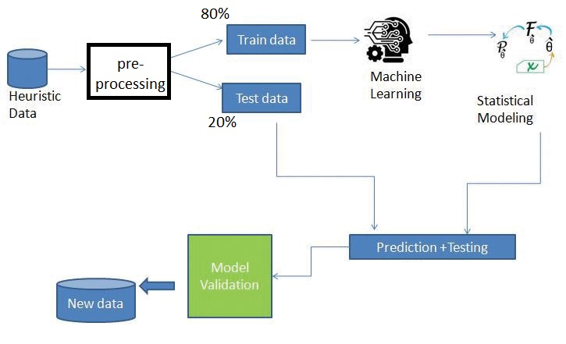
FLOW CHART

Slide 9
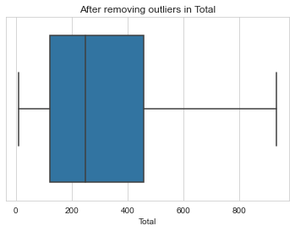
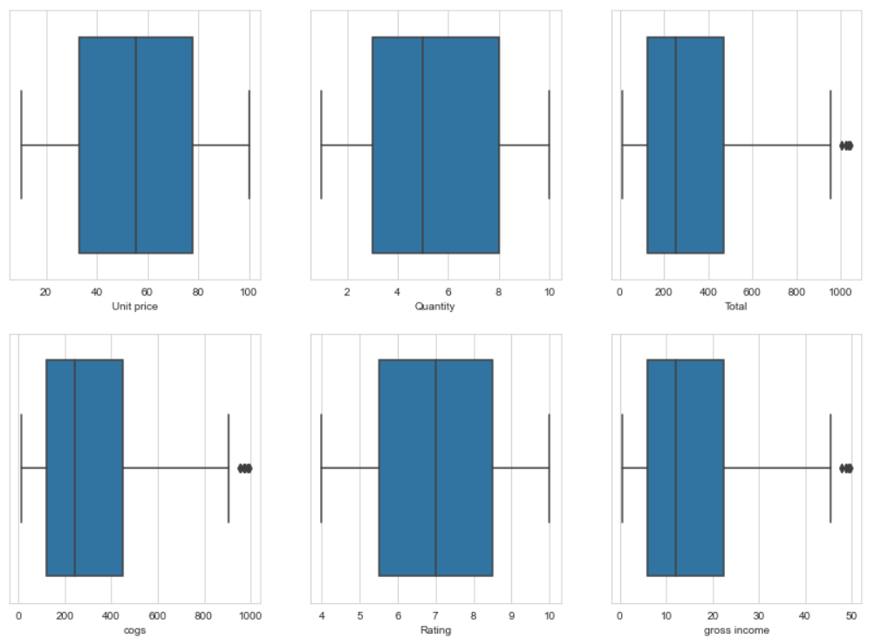

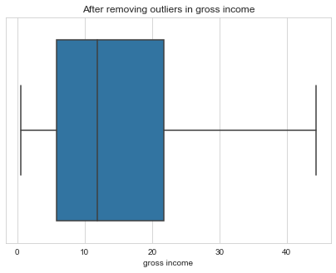
OUTLIER DETECTION AND REMOVAL:

Slide 10
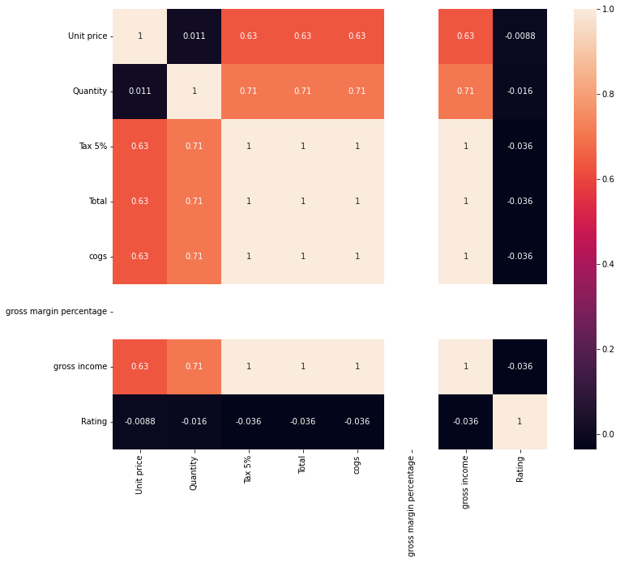
HEAT MAP:

Slide 11
Machine Learning MODEL
•The training set consists of 80% of dataset and is used to train these models with the labels
•The test set consists of 20% of dataset and is used to test the models by predicting the labels.
•Classification report and accuracy of each model gives us the accurate classifier.

Slide 12
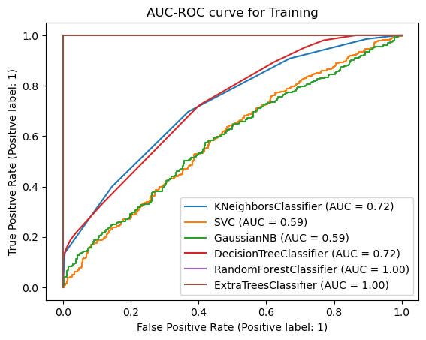
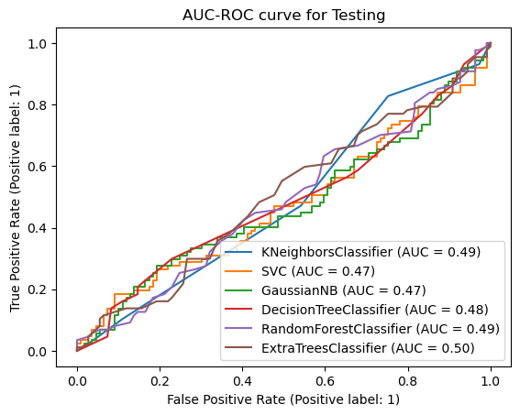
AUC - ROC curve for Training and Test score

Slide 13
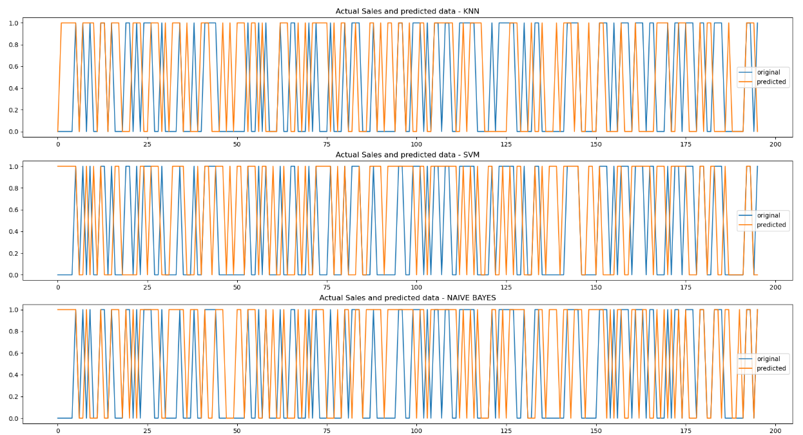

Slide 14
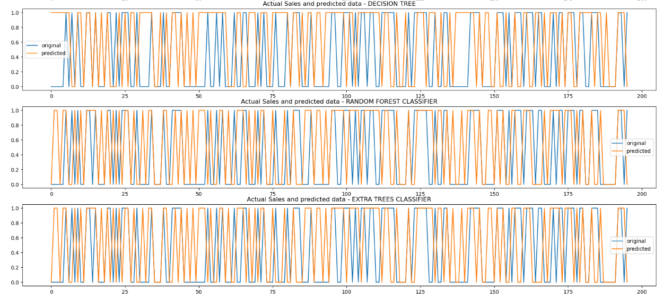

Slide 15
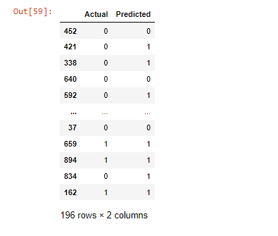
MODEL VALIDATION

Slide 16
ReFERENCE:
Singh Manpreet, Bhawick Ghutla, Reuben Lilo Jnr, Aesaan FS Mohammed, and Mahmood A. Rashid. "Walmart's Sales
Data Analysis-A Big Data Analytics Perspective." In 2017 4th Asia-Pacific World Congress on Computer Science and Engineering (APWC on CSE), pp. 114-119. IEEE, 2017.
Sekban, Judi. "Applying machine learning algorithms in sales prediction." (2019).
Ragg, Thomas, Wolfram Menzel, Walter Baum, and Michael Wigbers. "Bayesian learning for sales rate predictionfor thousands of retailers." Neurocomputing 43, no. 1-4 (2002): 127-144.
Intelligent Sales Prediction Using Machine Learning Technique, 2018. [ https://ieeexplore.ieee.org ]
https://www.kaggle.com/code/iabhishekbhardwaj/supermarket-sales-prediction-solution/notebook

Slide 17


